Slide 1
Propositional and First order(Predicate) Logic

Slide 2
Proposition
A proposition is the basic building block of logic. It is defined as a declarative sentence that is either True or False, but not both.
The Truth Value of a proposition is True(denoted as T) if it is a true statement, and False(denoted as F) if it is a false statement.
To represent propositions, propositional variables are used. By Convention, these variables are represented by small alphabets such as p, q, r, etc.

Slide 3
Proposition
Propositions constructed using one or more propositions are called compound propositions.
The propositions are combined using Logical Connectives or Logical Operators.

Slide 4
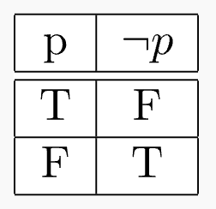
Logical Connectives
Negation (¬):
¬p -> not p

Slide 5
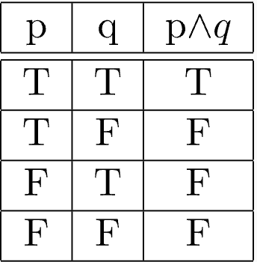
Logical Connectives
Conjunction (∧):
p∧q -> p and q

Slide 6
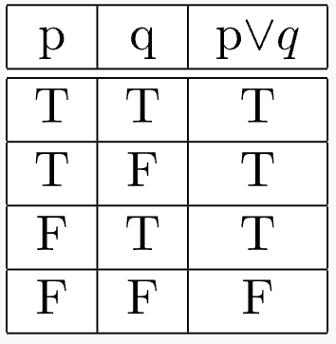
Logical Connectives
Disjunction (∨):
p∨q -> p or q

Slide 7
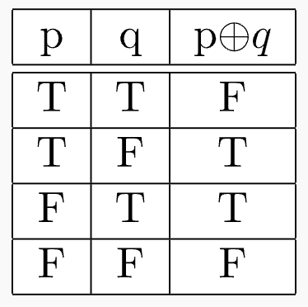
Logical Connectives
Exclusive-Or (⊕):
p⊕q -> either p or q, not both.

Slide 8
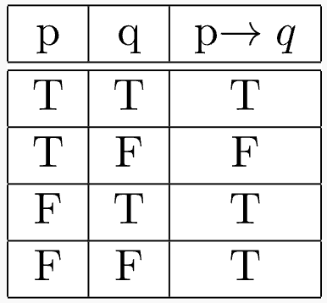
Logical Connectives
Implication (→):
p→q -> if p, then q. is also equivalent to (¬p∨q)
Explosion Principle – “A False statement implies anything”

Slide 9
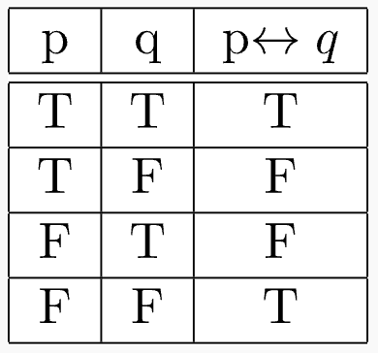
Logical Connectives
Double Implication (↔︎):
p↔︎q -> p, if and only if (or iff) q

Slide 10
Quick Question
Consider the following statements:
P: Good cell phones are not cheap.
Q: Cheap cell phones are not good.
L: P implies Q
M: Q implies P
N: P is equivalent to Q
Which one of the following about L, M, and N is CORRECT?
(A) Only L is TRUE.
(B) Only M is TRUE.
(C) Only N is TRUE.
(D) L, M and N are TRUE.

Slide 11
Laws of Algebra of Propositions
Idempotent law: p ∨ p ≅ p, p ∧ p ≅ p
Associative law: (p ∨ q) ∨ r ≅ p ∨ (q ∨ r)
Distributive law: p ∨ (q ∧ r) ≡ (p ∨ q) ∧ (p ∨ r)
Commutative Law: p ∨ q ≅ q ∨ p
Identity Law: p ∨ T ≅ T, p ∨ F ≅ p, p ∧ T ≅ p, p ∧ F ≅ F
De Morgan’s Law: ¬ (p ∧ q) ≡ ¬p ∨ ¬q
Special Conditional Statements:
Implication: p→q
Converse of the implication: q→p
Inverse of the implication: ¬p→¬q
Contra-positive of the implication: ¬q→¬p
Note: Inverse and converse are equivalent, the statement and contra-positive are equivalent.

Slide 12
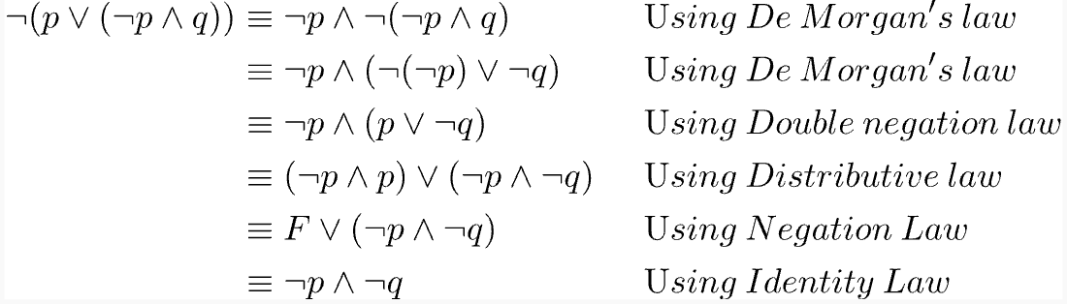
Propositional Equivalences
Ex: Show that ¬(p ∨ (¬p ∧ q)) ≡ ¬p ∧ ¬q
Solution:

Slide 13
Predicate Logic
Adds the concept of predicates and quantifiers to better capture the meaning of statements that cannot be adequately expressed by propositional logic.
The predicate P can be considered as a function. It tells the truth value of the statement P(x) at x.
Ex: P(x) denotes the statement x>3. Therefore, P(2) is False, P(5) is True.

Slide 14
Quantifiers
In predicate logic, predicates are used alongside quantifiers to express the extent to which a predicate is true over a range of elements.
Two types:
Universal Quantification: The notation ∀ P(x) denotes the universal quantification of P(x).
Ex: Let P(x) be the statement x + 2 > x. The truth value of ∀x P(x) is T.
Existential Quantification: The notation ∃P(x) denotes the existential quantification of P(x).
Ex: Let P(x) be the statement x > 5. The truth value of ∃x P(x) is T.

Slide 15
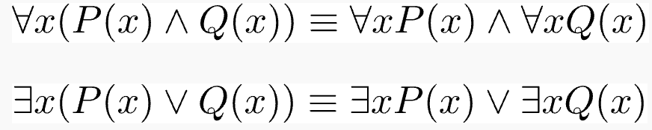


Logical Equivalences including Quantifiers
Negating Quantified Statements

Slide 16
Questions

Slide 17
What is the logical translation of the following statement?
"None of my friends are perfect.”
Ans: D

Slide 18
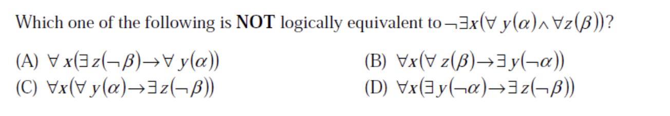
Ans: A and D

Slide 19
Relations,Functions, Partial Orders and Lattices

Slide 20
Number of possible Equivalence Relations on a finite set
An equivalence relation is Reflexive, Symmetric and Transitive for a relation R in set A.
Reflexive i.e (a, a) ∈ R, for every a ∈ A.
Symmetric if (p, q) ∈ R, then (q, p) ∈ R
Transitive if (a, b), (b,c) ∈ R, then (a, c) ∈ R.
Every equivalence relation corresponds to a partition of the set.
So the total number of equivalent relations is the number of ways you can partition a set.

Slide 21


1
1 2
2 3 5
5 7 10 15
15 20 27 37 52
Where n is the size of the set and k is the number of non-empty datasets it can be partitioned into.

Slide 22
Partial orders and lattices
A relation is a partial order if it is reflexive, anti-symmetric and transitive. A set with partial ordering is called poset.
Anti-symmetric : if (a, b) ∈ R and (b, a) ∈ R, then a=b.
Q) Show that the inclusion relation is a partial ordering on the power set of a set.
Comparability: Let a and b be the elements of a poset (S,R), then a and b are said to be comparable if either a R b or b R a where R is a relation. Otherwise, a and b are said to be incomparable.
Totally ordered set is a poset where all the elements are comparable. Also called a chain.

Slide 23
Hasse diagrams
A partial order, being a relation, can be represented by a di-graph. But most of the edges do not need to be shown since it would be redundant.
In general, a partial order on a finite set can be represented using the following procedure is as follows:
Remove all self-loops from all the vertices. This removes all edges showing reflexivity.
Remove all edges which are present due to transitivity i.e., if (a,b) and (b,c) are in the partial order, then remove the edge (a,c) . Furthermore if (c,d) is in partial order, then remove the edge (a,d) .
Arrange all edges such that the initial vertex is below the terminal vertex.
Remove all arrows on the directed edges, since all edges point upwards.

Slide 24
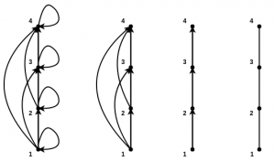
S =({1,2,3,4},<=)

Slide 25
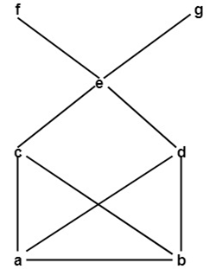
Upper Bound: Consider B be a subset of a partially ordered set A. An element x ∈ A is called an upper bound of B if y ≤ x for every y ∈ B. Lowest upper bound is the least of these values.
Lower Bound: Consider B be a subset of a partially ordered set A. An element z ∈ A is called a lower bound of B if z ≤ x for every x ∈ B. Greatest lower bound is highest of these values.

Slide 26

Lattices
A Poset in which every pair of elements has both, a least upper bound and a greatest lower bound is called a lattice. There are two binary operations defined for lattices –
Join: The join of two elements is their least upper bound. It is denoted by
Meet: The meet of two elements is their greatest lower bound. It is denoted b
Identities for join and meet:
For distributive lattice:

Slide 27
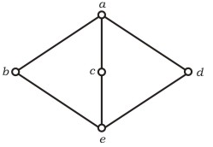
Q) The following is the Hasse diagram of the poset [{a, b, c, d, e}, ≤]
The poset is
(A) not a lattice
(B) a lattice but not a distributive lattice
(C) a distributive lattice but not a Boolean algebra
(D) a Boolean algebra

Slide 28
Functions
A function f from A to B is an assignment of exactly one element of B to each element of A (A and B are non-empty sets).
If b is the unique element of B assigned by the function f to the element a of A, it is written as f(a) = b.
Domain and co-domain – if f is a function from set A to set B, then A is called Domain and B is called co-domain.
Range – Range of f is the set of all images of elements of A. Basically Range is subset of co- domain.
Image and Pre-Image – b is the image of a and a is the pre-image of b if f(a) = b.

Slide 29
Properties
1) Addition and multiplication: let f1 and f2 are two functions from A to B, then f1 + f2 and f1.f2 are defined as-:
f1+f2(x) = f1(x) + f2(x). (addition)
f1f2(x) = f1(x) f2(x). (multiplication)
2) Equality: Two functions are equal only when they have same domain, same co-domain and same mapping elements from domain to co-domain.

Slide 30
Types of functions
One to one function(Injective): A function is called one to one if for all elements a and b in A, if f(a) = f(b),then it must be the case that a = b. It never maps distinct elements of its domain to the same element of its co-domain.
Onto Function (surjective): If every element b in B has a corresponding element a in A such that f(a) = b. It is not required that a is unique; The function f may map one or more elements of A to the same element of B.
One to one correspondence function(Bijective/Invertible): A function is Bijective function if it is both one to one and onto function. Bijective functions are invertible i.e f(a) = b,hence f-1 (b) = a.

Slide 31
Strictly Increasing and Strictly decreasing functions: A function f is strictly increasing if f(x) > f(y) when x>y. A function f is strictly decreasing if f(x) < f(y) when x<y.
Increasing and decreasing functions: A function f is increasing if f(x) ≥ f(y) when x>y. A function f is decreasing if f(x) ≤ f(y) when x<y.
A function is one to one if it is either strictly increasing or strictly decreasing.
For onto function, range and co-domain are equal.

Slide 32
Inverse and composite functions
Two functions f and g are said to be inverses of each other if and only if:
f and g are both one to one functions. One to One functions map each value in their domain to exactly one value in the co-domain(range). An example of a one-to-one function is f(x) = x
The co-domain(range) of f is the domain of g and vice versa.
A composite function is a function whose input is another function. So, if we have two functions A(x), which maps elements from set B to set C, and B(x), which maps from set C to set E, then the composite of these two functions, written as BoA, is a function that maps elements from B to E i.e. BoA = B(A(x)).

Slide 33
Properties of Composite functions
f-1 of = f-1 (f(a)) = f-1(b) = a.
fof-1 = f(f-1 (b)) = f(a) = b.
If f and g both are one to one function, then fog is also one to one.
If f and g both are onto function, then fog is also onto.
If f and fog both are one to one function, then g is also one to one.
If f and fog are onto, then it is not necessary that g is also onto.
(fog)-1 = g-1 o f-1
Associative but not commutative i.e (fog)oh=fo(goh) and fog !=gof

Slide 34
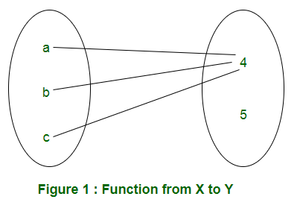
Total possible functions
Let X and Y are two sets having m and n elements respectively. In a function from X to Y, every element of X must be mapped to an element of Y. Therefore, each element of X has ‘n’ elements to be chosen from. Therefore, total number of functions will be n×n×n.. m times = n^m.

Slide 35
Q) Let X, Y, Z be sets of sizes x, y and z respectively. Let W = X x Y. Let E be the set of all subsets of W. The number of functions from Z to E is:
(A) z^xy
(B) z^2xy
(C) z^2x + y
(D) 2^xyz

Slide 36
Number of onto functions from one set to another – In onto function from X to Y, all the elements of Y must be used.
If X has m elements and Y has n elements, the number if onto functions are
If m < n, the number of onto functions is 0 as it is not possible to use all elements of Y.
Number of one-to-one functions if X has m elements and Y has n (m>n) are (mCn)⋅n!
If bijective i.e m=n then m! functions are possible.

Slide 37
Q) The number of onto functions (surjective functions) from set X = {1, 2, 3, 4} to set Y = {a, b, c,d} is:
(A) 36
(B) 64
(C) 81
(D) 72

Slide 38
Sets

Slide 39
Sets
A Set is an unordered collection of objects, known as elements or members of the set.

Slide 40
Representation of a Set
Statement form
well-defined description of the elements of the set is given
Example: The set of all-even numbers less than 10.
Roaster form
elements are listed within the pair of brackets {} and are separated by commas.
Example: {1, 2}
Set builder form
described by a property that its member must satisfy
Example: {x : x is natural number less than 10}

Slide 41
Equal sets
Two sets are said to be equal if both have same elements. For example A = {1, 3, 9, 7} and B = {3, 1, 7, 9} are equal sets.

Slide 42
Subset
A set A is said to be subset of another set B if and only if every element of set A is also a part of other set B. Denoted by ‘⊆‘.
‘A ⊆ B ‘ denotes A is a subset of B.

Slide 43
Size of a Set
Size of a set can be finite or infinite.
Size of the set S is known as Cardinality number, denoted as |S|.
Example:
A = {1,3,5,7,9}, Cardinality of the set is 5, i.e.,|A| = 5.

Slide 44
Power Sets
The power set is the set of all possible subsets of the set S. Denoted by P(S).
Example: power set of {0,1,2}: {∅}, {0}, {1}, {2}, {0,1}, {0,2}, {1,2}, {0,1,2}
Cardinality of power set is 2 power n

Slide 45
Cartesian Products
Let A and B be two sets. Cartesian product of A and B is denoted by A × B, is the set of all ordered pairs (a,b), where a belong to A and b belong to B.
A × B = {(a, b) | a ∈ A ∧ b ∈ B}.
Example: Cartesian product of A = {1,2} and B = {p, q, r}: A × B ={(1, p), (1, q), (1, r), (2, p), (2, q), (2, r) };
The cardinality of A × B is N*M, where N is A’s cardinality and M is B’s cardinality.

Slide 46
Set Operations

Slide 47
Union
Union of the sets A and B, denoted by A ∪ B, is the set of distinct elements that belong to set A or set B, or both
Example: Find the union of A = {2, 3, 4} and B = {3, 4, 5};
Solution : A ∪ B = {2, 3, 4, 5}.

Slide 48
Intersection
The intersection of the sets A and B, denoted by A ∩ B, is the set of elements that belong to both A and B i.e. set of the common elements in A and B.
Example: Find the intersection of A = {2, 3, 4} and B = {3, 4, 5}
Solution : A ∩ B = {3, 4}.

Slide 49
Disjoint
Two sets are said to be disjoint if their intersection is the empty set. i.e, sets have no common elements.
Example: Let A = {1, 3, 5, 7, 9} and B = { 2, 4, 6, 8}
A and B are disjoint sets since both of them have no common elements.

Slide 50
Set Difference
The difference between sets is denoted by ‘A – B’, which is the set containing elements that are in A but not in B. i.e., all elements of A except the element of B.
Example: If A = {1, 2, 3, 4, 5} and B = { 2, 4, 6, 8}, find A-B
Solution: A-B = {1, 3, 5}

Slide 51
Complement
The complement of a set A, denoted by A^{C} is the set of all the elements except the elements in A. Complement of the set A is U – A.
Example: Let U = {1, 2, 3, 4, 5, 6, 7, 8, 9, 10} and A = {2, 4, 6, 8}.
Find A^{C}
Solution: A^{C}= U-A = {1, 3, 5, 7, 9, 10}

Slide 52
Theorems on set operations
Several general laws about sets follow from the definitions of set-theoretic operations, subsets, etc. A useful selection of these is shown below. They are grouped under their traditional names. These equations below hold for any sets X, Y, Z: 1. Idempotent Laws (a) X ∪ X = X (b) X ∩ X = X 2. Commutative Laws (a) X ∪ Y = Y ∪ X (b) X ∩ Y = Y ∩ X 3. Associative Laws (a) (X ∪ Y) ∪ Z = X ∪ (Y ∪ Z) (b) (X ∩ Y) ∩Z = X ∩ (Y ∩ Z) 4. Distributive Laws (a) X ∪ (Y ∩ Z) = (X ∪ Y) ∩ (X ∪ Z) (b) X ∩ (Y ∪ Z) = (X ∩ Y) ∪ (X ∩ Z)

Slide 53
Theorems on set operations
5. Identity Laws (a) X ∪ ∅ = X (c) X ∩ ∅ = ∅ (b) X ∪ U = U (d) X ∩ U = X 6. Complement Laws (a) X ∪ X’ = U (c) X ∩ X’ = ∅ (b) (X’)’ = X (d) X – Y = X ∩ Y’ 7. DeMorgan’s Laws (a) (X ∪ Y)’ = X’ ∩ Y’ (b) (X ∩ Y)’ = X’ ∪ Y’ 8. Consistency Principle (a) X ⊆ Y iff X ∪ Y = Y (b) X ⊆ Y iff X ∩ Y = X

Slide 54
Relations

Slide 55
Relation
Relation or Binary relation R from set A to B is a subset of AxB which can be defined as aRb ↔ (a,b) € R ↔ R(a,b).
A Binary relation R on a single set A is defined as a subset of AxA.
For two distinct set, A and B with cardinalities m and n, the maximum cardinality of the relation R from A to B is mn.

Slide 56
Domain and Range:
if there are two sets A and B and Relation from A to B is R(a,b),
Domain is defined as the set { a | (a,b) € R for some b in B}
Range is defined as the set {b | (a,b) € R for some a in A}.

Slide 57
Types of Relation:
Empty Relation: A relation R on a set A is called Empty if the set A is empty set.
Full Relation: A binary relation R on a set A and B is called full if AXB.
Reflexive Relation: A relation R on a set A is called reflexive if (a,a) € R holds for every element a € A .i.e. if set A = {a,b} then R = {(a,a), (b,b)} is reflexive relation.
Irreflexive relation : A relation R on a set A is called reflexive if no (a,a) € R holds for every element a € A.i.e. if set A = {a,b} then R = {(a,b), (b,a)} is irreflexive relation.
Symmetric Relation: A relation R on a set A is called symmetric if (b,a) € R holds when (a,b) € R.i.e. The relation R={(4,5),(5,4),(6,5),(5,6)} on set A={4,5,6} is symmetric.

Slide 58
Types of Relation:
4. AntiSymmetric Relation: A relation R on a set A is called antisymmetric if (a,b)€ R and (b,a) € R ,then a = b is called antisymmetric.i.e. The relation R = {(a,b)→ R|a ≤ b} is anti-symmetric since a ≤ b and b ≤ a implies a = b.
5. Transitive Relation: A relation R on a set A is called transitive if (a,b) € R and (b,c) € R then (a,c) € R for all a,b,c € A.i.e. Relation R={(1,2),(2,3),(1,3)} on set A={1,2,3} is transitive.
6. Equivalence Relation: A relation is an Equivalence Relation if it is reflexive, symmetric, and transitive. i.e. relation R={(1,1),(2,2),(3,3),(1,2),(2,1),(2,3),(3,2),(1,3),(3,1)} on set A={1,2,3} is equivalence relation as it is reflexive, symmetric, and transitive. Number of equivalence relation in a set containing n elements is given by Bell number.
7. Asymmetric relation: Asymmetric relation is opposite of symmetric relation. A relation R on a set A is called asymmetric if no (b,a) € R when (a,b) € R.

Slide 59

Combining Relations :
Union – R1 ∪ R2 consists of all ordered pairs from both relations. Duplicate ordered pairs removed from Union.
Intersection – R1 ∩ R2 consists of ordered pairs which are in both relations.
Difference – R1-R2 consists of all ordered pairs only in R1 but not in R2.
Symmetric Difference – consists of all ordered pairs which are either in R1 or R2 but not both

Slide 60
Composition
Let R be a relation from A to B and S be a relation from B to C, then the composite of R and S, denoted by S o R, is the relation consisting of ordered pairs (a,c) where a € A, c € C and for which there exists an element b € B such that (a, b) € R and (b, c) € S
Example: What is the composite of the relations R and S where R is a relation from {1, 2, 3} to {1, 2, 3, 4} with R = {(1,1), (1,4), (2,3), (3,1), (3,4)} and S is a relation from {1, 2, 3, 4} to {0, 1, 2} with S = {(1,0), (2,0), (3,1), (3,2), (4,1)}?
Solution – By computing all ordered pairs where the first element belongs to R and the second element belongs to S, we get –
S o R = {(1,0), (1,1), (2,1), (2,2), (3,0), (3,1)}

Slide 61
Composition of Relation on itself :
A relation can be composed with itself to obtain a degree of separation between the elements of the set on which R is defined.
Let R be a relation on the Set A
The powers of R^n where n =1, 2, 3 .. Are defined recursively by R^1=R and R^n = R^n-1 o R

Slide 62
Equivalence Relations :
Let R be a relation on set A. If R is reflexive, symmetric, and transitive then it is said to be an equivalence relation.
Consequently, two elements, a and b related by an equivalence relation are said to be equivalent
Example: Show that the relation
R = {(a,b): a≡ b (mod m)} is an equivalence relation. a ≡ b (mod m) is the congruence modulo m function. It is true if and only if m divides a-b.

Slide 63
Solution
To show that the relation is an equivalence relation we must prove that the relation is reflexive, symmetric and transitive.
Reflexive – For any element a, a - a = 0 is divisible by m. therefore
a ≡ a (mod m). So, congruence modulo m is reflexive.
Symmetric – For any two elements a and b, if (a,b) ∈ R or a ≡ b (mod m) i.e. a - b is divisible by m, then b - a is also divisible by m.
therefore b ≡ a (mod m). So Congruence Modulo m is symmetric.
Transitive – For any three elements a, b, and c if (a,b), (b,c) \in R then-
(a-b) mod m = 0
(b-c) mod m = 0
Adding both equations,

Slide 64
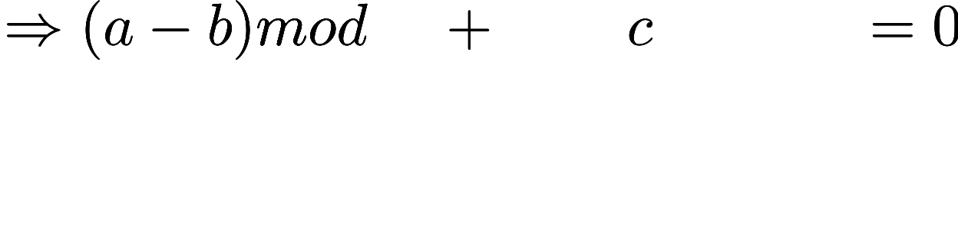
Solution
therefore a ≡ c (mod m). So, R is transitive.
Since the relation R is reflexive, symmetric, and transitive, we conclude that R is an equivalence relation.

Slide 65
Questions

Slide 66
Questions
If P, Q, R are subsets of the universal set U, then
(A) P^{C}U R^{C}
(B) P U Q^{C} U R^{C}
(C) P^{C} U Q^{C} U R^{C}
(D) U

Slide 67
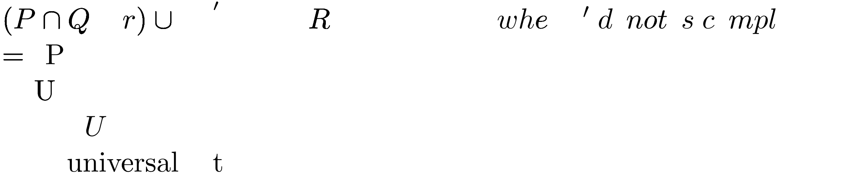
Solution

Slide 68
Question
Consider the binary relation R = {(x, y), (x, z), (z, x), (z, y)} on the set {x, y, z}. Which one of the following is TRUE? (A) R is symmetric but NOT antisymmetric (B) R is NOT symmetric but antisymmetric (C) R is both symmetric and antisymmetric (D) R is neither symmetric nor antisymmetric

Slide 69
Solution
R is not symmetric as (x, y) is present, but (y, x) is not present in R.
R is also not antisymmetric as both (x, z) and (z, x) are present in R.

Slide 70
Question
For a set A, the power set of A is denoted by 2^{A}. If A = {5, {6}, {7}}, which of the following options are True.
(A) I and III only (B) II and III only (C) I, II and III only (D) I, II and IV only

Slide 71
Solution
A = {5, {6}, {7}}
Below is Powerset of A
{ φ, {5}, {{6}}, {{7}}, {5, {6}}, {5, {7}}, {{6}, {7}}, {5, {6}, {7}}}
I is true, as φ belongs to Powerset.
II is true, as an empty set is a subset of every set.
III is true as {5, {6}} belongs to Powerset.
IV is false, {5, {6}} is not a subset, but {{5, {6}}} is.

Slide 72
Question
Consider the following relation on subsets of the set S of integers between 1 and 2014. For two distinct subsets U and V of S we say U < V if the minimum element in the symmetric difference of the two sets is in U.
Consider the following two statements:
S1: There is a subset of S that is larger than every other subset.
S2: There is a subset of S that is smaller than every other subset.
Which one of the following is CORRECT?
(A) Both S1 and S2 are true
(B) S1 is true and S2 is false
(C) S2 is true and S1 is false
(D) Neither S1 nor S2 is true

Slide 73
Solution
As question defined that “for two distinct subsets U and V of S we say U < V if the minimum element in the symmetric difference of the two sets is in U". Given, S = {1, 2, 3, …., 2014}. Therefore, Subsets {1, 2, 3, …., 2014} and {Ø} of S, so {1, 2, 3, …., 2014} < {Ø} because the minimum element in the symmetric difference (i.e., {1, 2, 3, …., 2014}) of the two sets is in set {1, 2, 3, …., 2014}. Hence, {Ø} is a subset of S that is larger than every other subset. And, {1, 2, 3, …., 2014} is a subset of S that is smaller than every other subset. Option (A) is correct

Slide 74
Question
The binary relation S = ф (empty set) on set A = {1, 2, 3} is : (A) Neither reflexive nor symmetric (B) Symmetric and reflexive (C) Transitive and reflexive (D) Transitive and symmetric

Slide 75
Solution
Reflexive : A relation is reflexive if every element of set is paired with itself. Here none of the element of A is paired with themselves, so S is not reflexive.
Symmetric : This property says that if there is a pair (a, b) in S, then there must be a pair (b, a) in S. Since there is no pair here in S, this is trivially true, so S is symmetric.
Transitive : This says that if there are pairs (a, b) and (b, c) in S, then there must be pair (a,c) in S. Again, this condition is trivially true, so S is transitive.
Thus, option (D) is correct

Slide 76
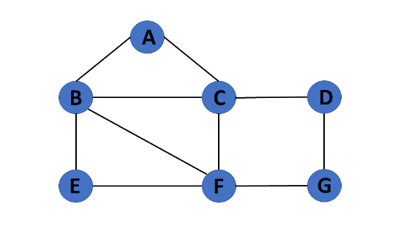
Graphs: Connectivity and Coloring

Slide 77
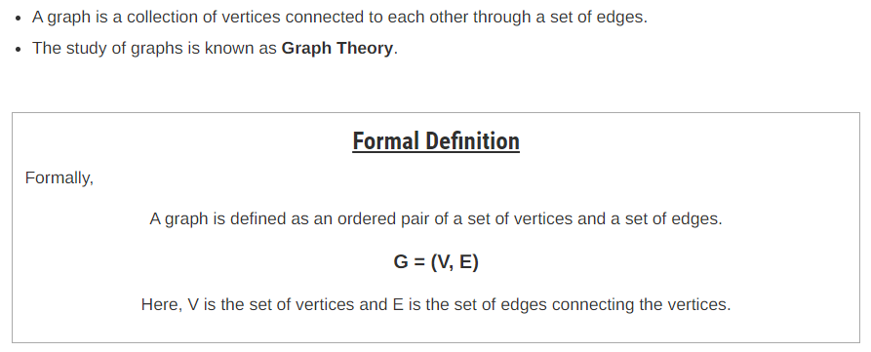
Definition
At Contoso, we empower organizations to foster collaborative thinking to further drive workplace innovation. By closing the loop and leveraging agile frameworks, we help business grow organically and foster a consumer-first mindset.​

Slide 78
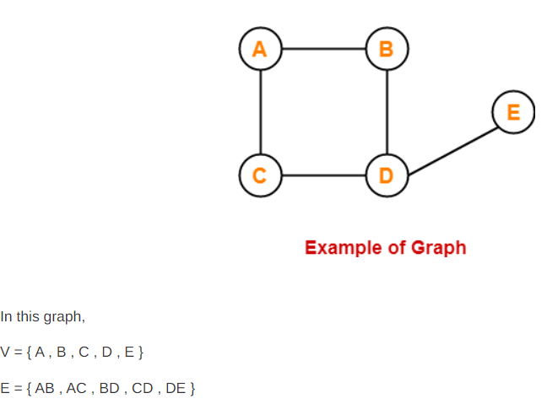
Example

Slide 79
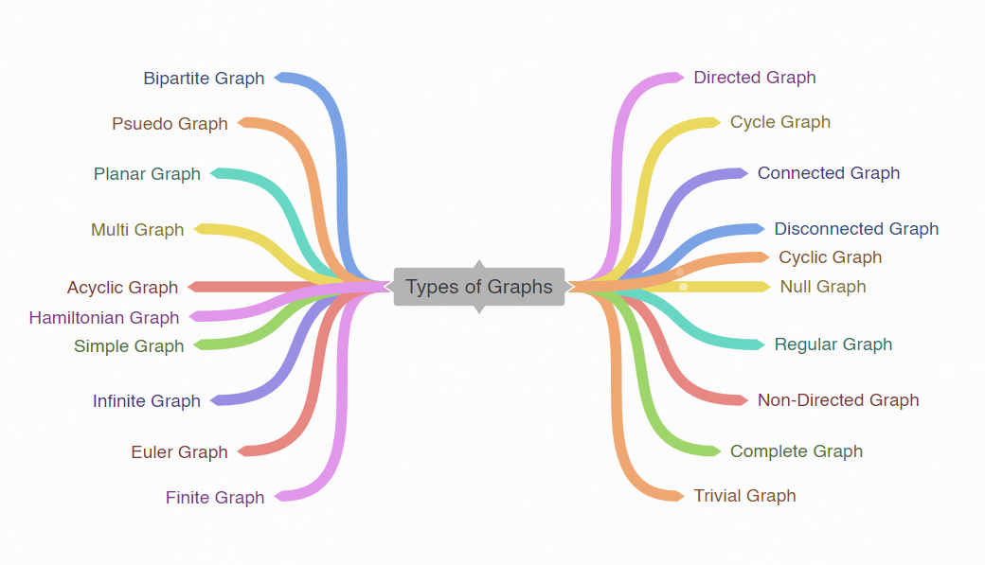
Types of Graphs

Slide 80
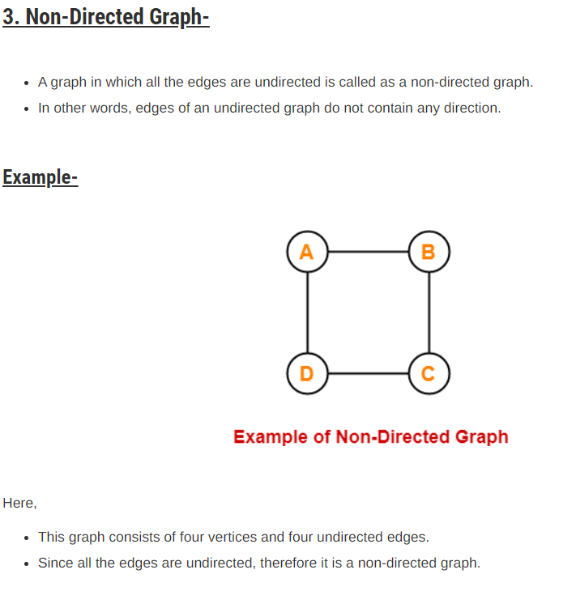
Non-Directed Graph

Slide 81
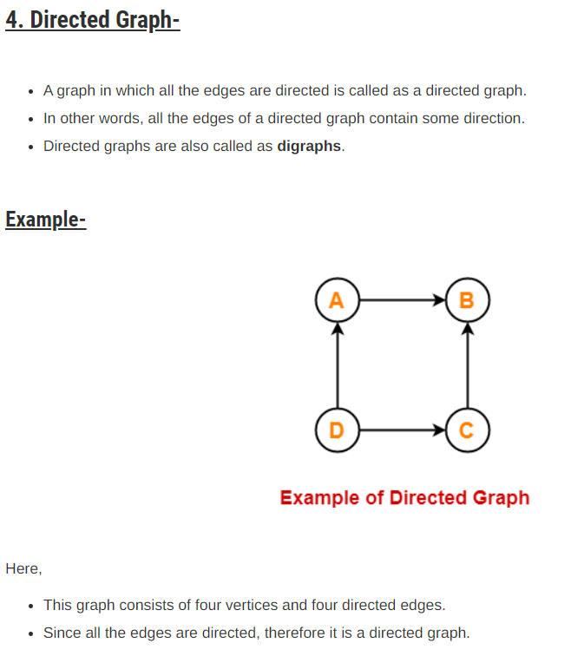
Directed Graph

Slide 82
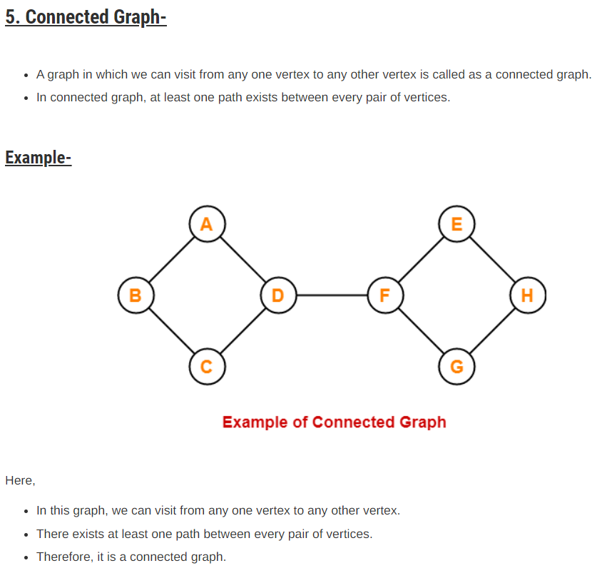
Connected Graph

Slide 83
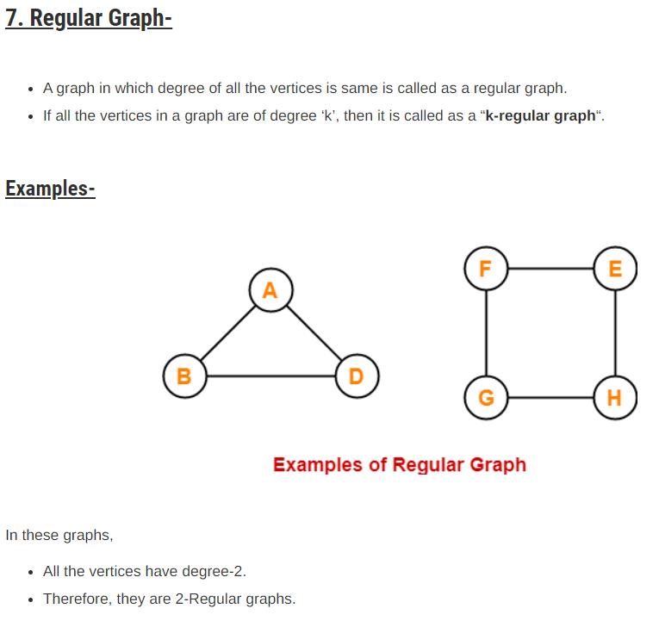
Regular Graph

Slide 84
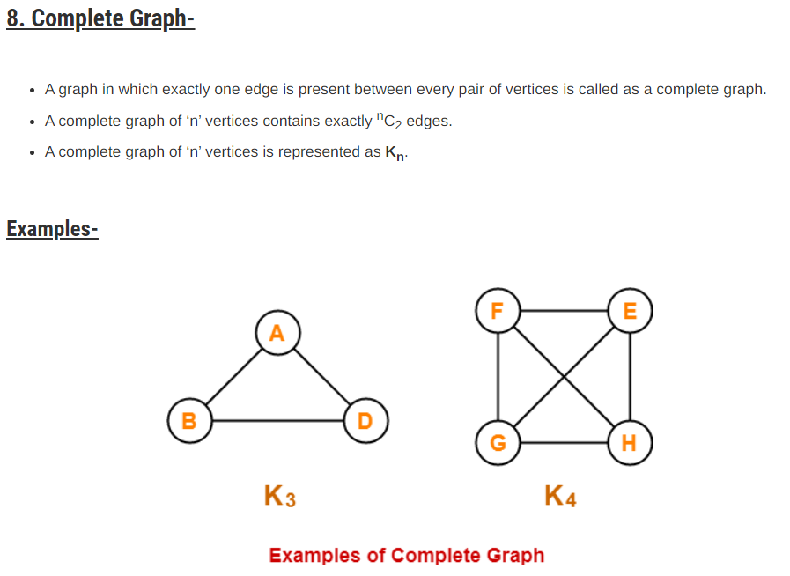
Complete Graph

Slide 85
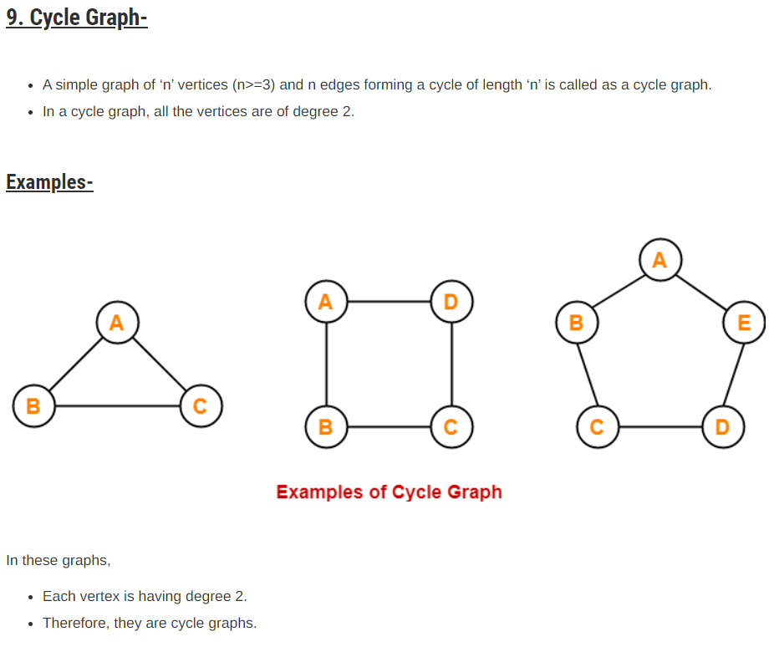
Cycle Graph

Slide 86
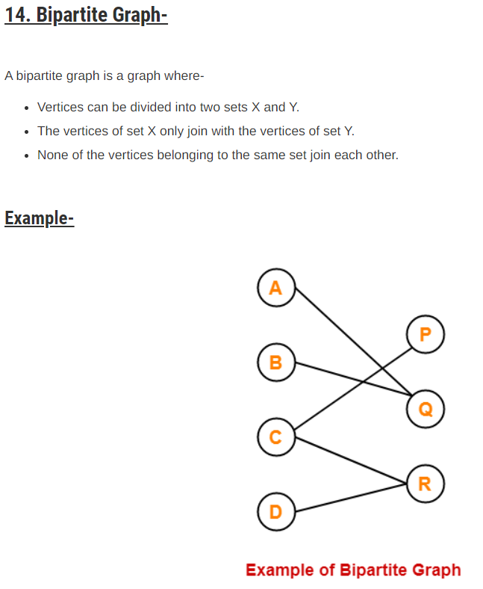
Bipartite Graph

Slide 87
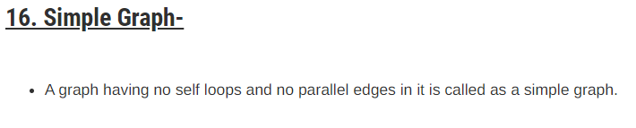
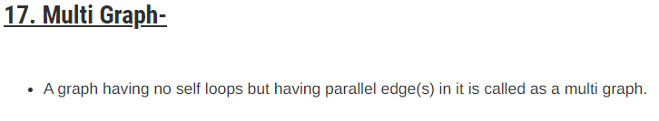
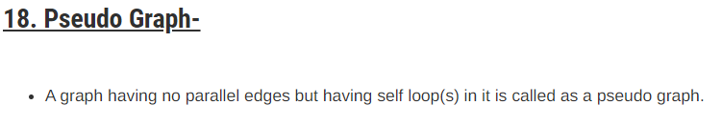
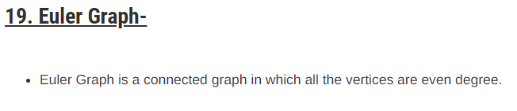

Slide 88
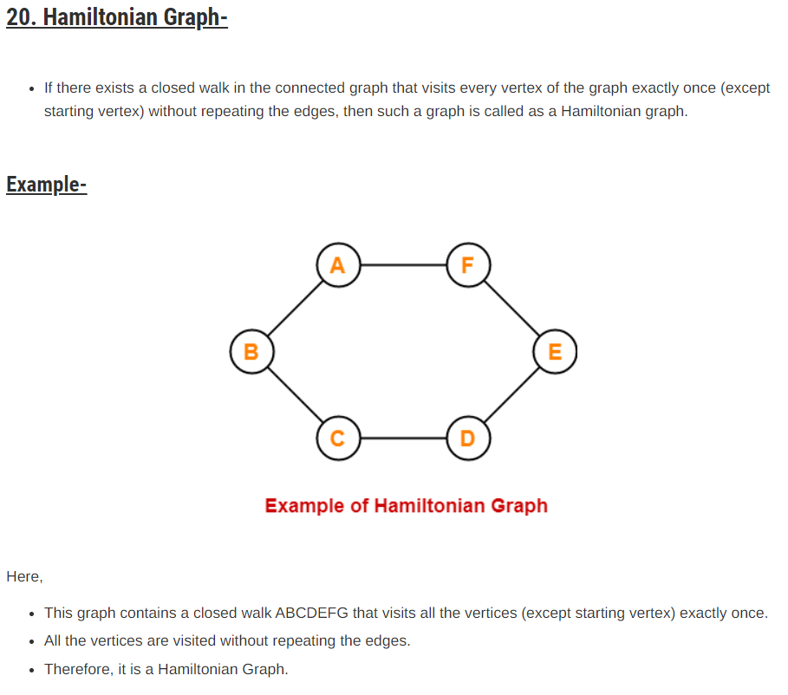
Hamiltonian Graph

Slide 89
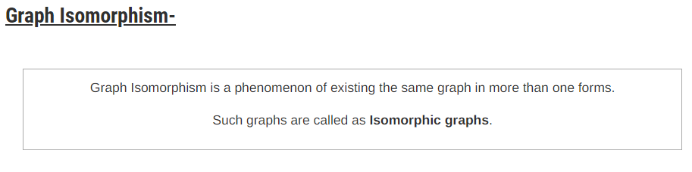
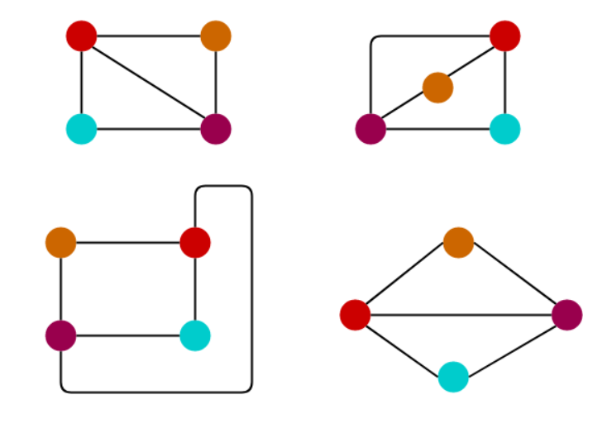
Isomorphism

Slide 90
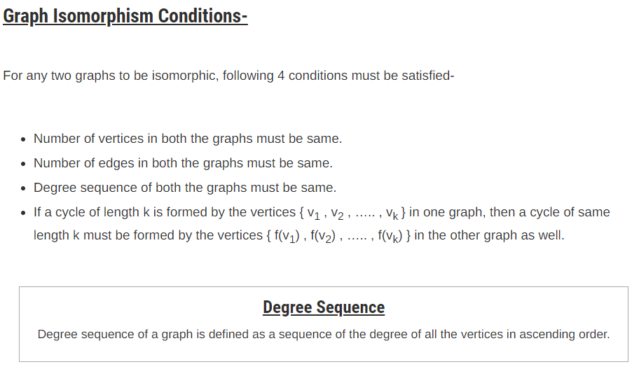

Slide 91
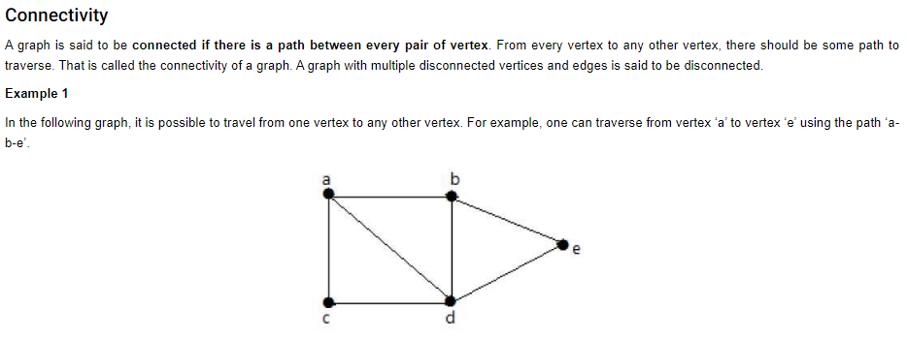

Slide 92
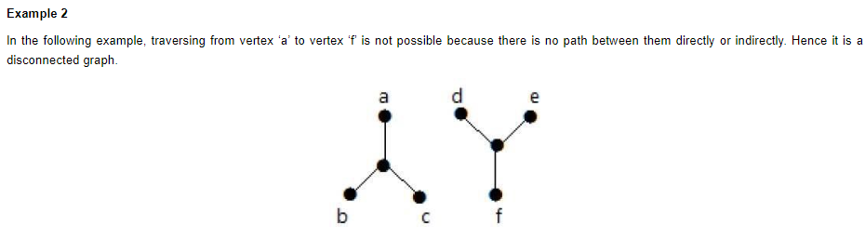

Slide 93
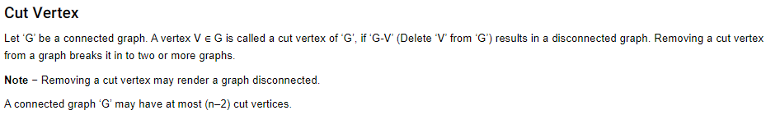
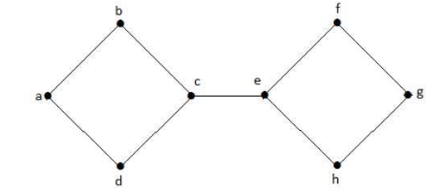

Slide 94
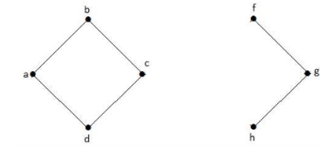

Slide 95


Slide 96
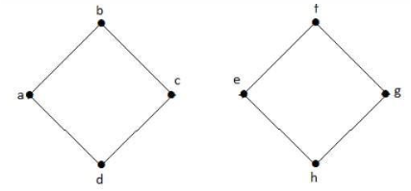

Slide 97
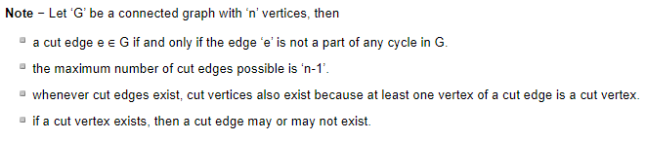

Slide 98
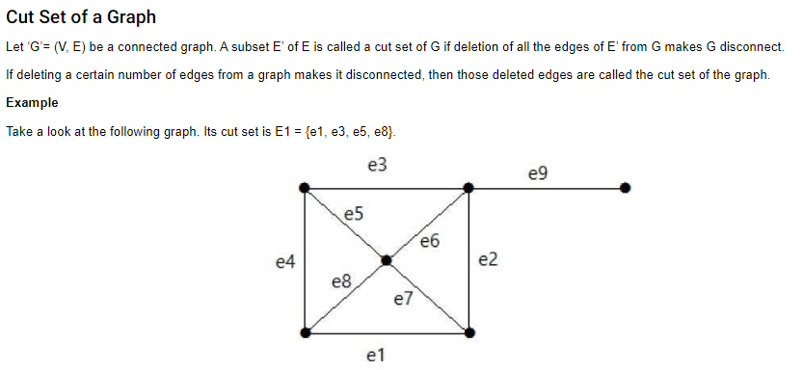

Slide 99
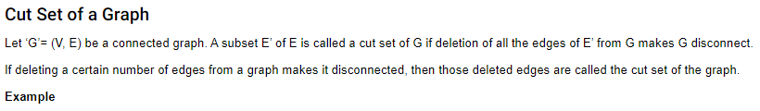
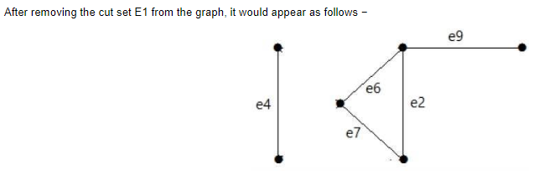

Slide 100
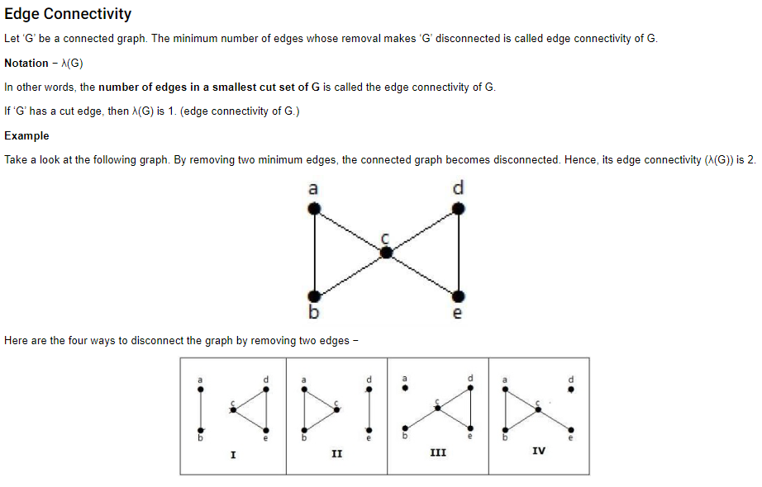

Slide 101
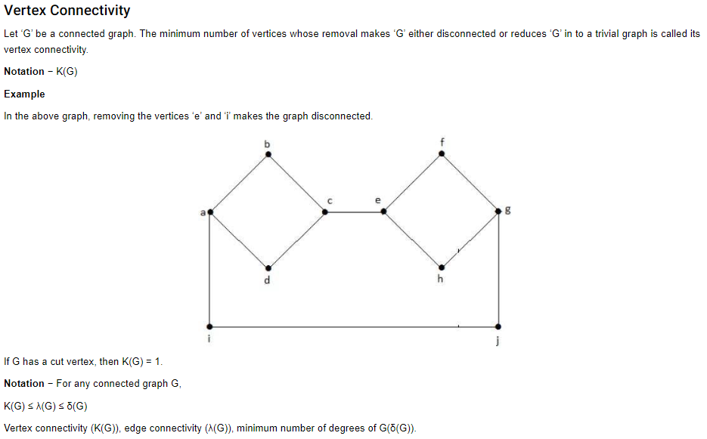

Slide 102
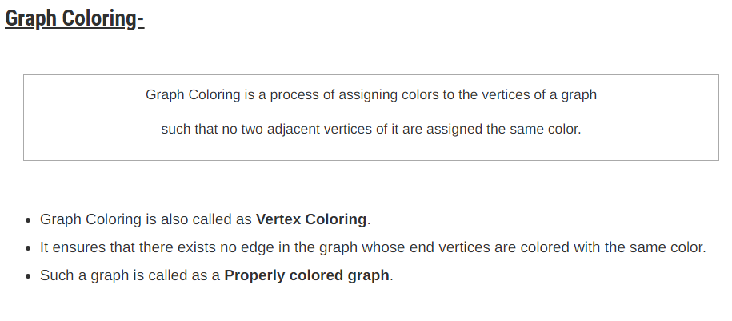

Slide 103
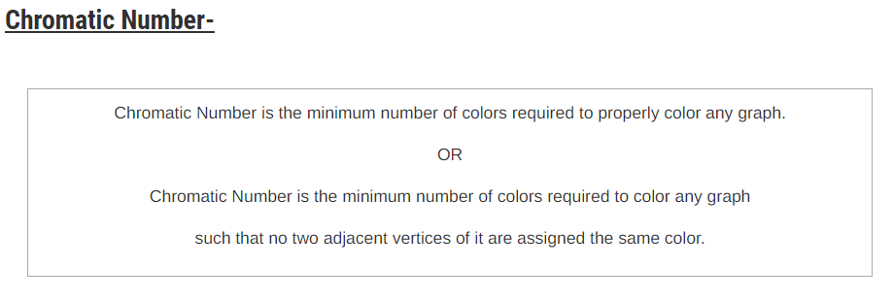

Slide 104
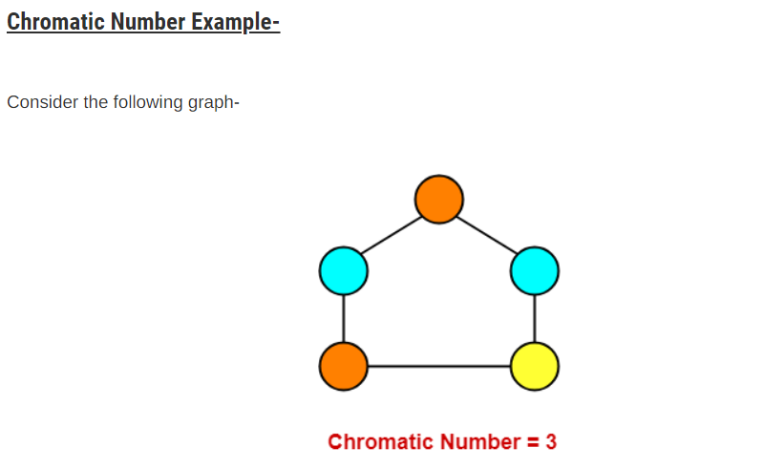

Slide 105
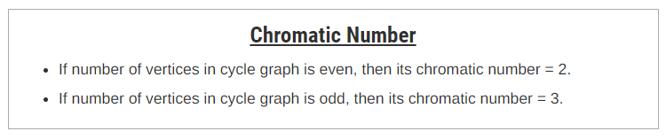








Slide 106



Slide 107


Slide 108


Slide 109
Answer: 2

Slide 110


Slide 111
Answer: D

Slide 113


Slide 114
Answer: 3

Slide 115


Slide 116
Answer: B

Slide 117


Slide 118
Answer: 19

Slide 119



Slide 120
Answer:
(a): (ii)
(b): 2

Slide 121


Slide 123
Answer: 19

